Slide 1
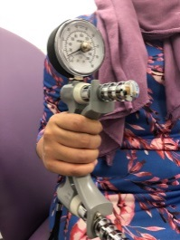
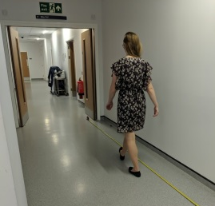
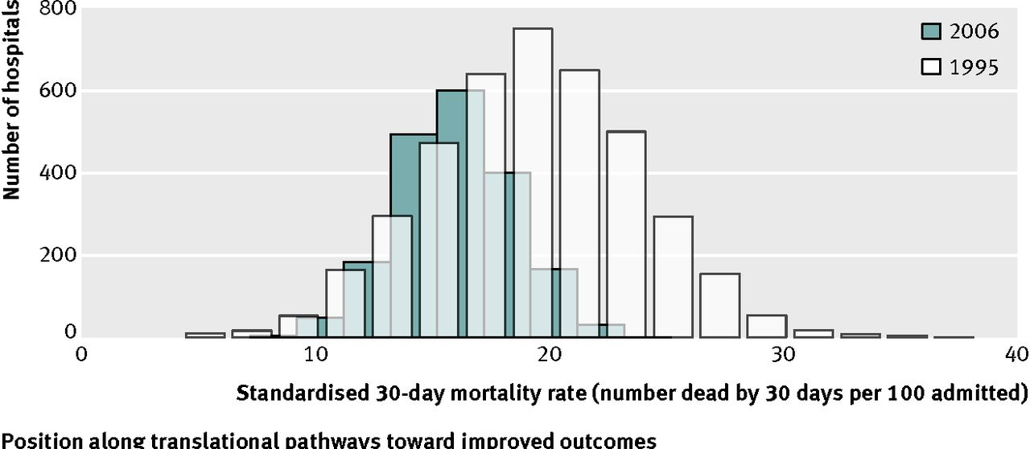
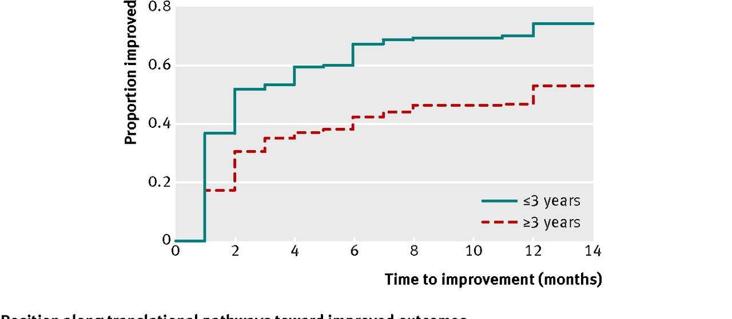
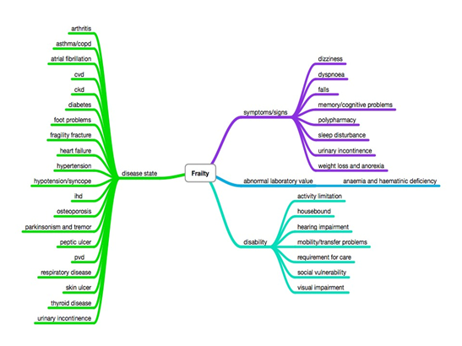
Introducing the FORCE:SEE Study – Frailty and Outcomes Record in Clinical Environments: probable Sarcopenia, geriatric Evaluation, and Events
Geriatric Medicine Research Collaborative
Probable sarcopenia
Within 48 hours of admission
Handgrip strength, short physical performance battery, brief questionnaires, routinely collected data
3 days after visit 1 (if still inpatient)
Handgrip strength, short physical performance battery, brief questionnaires, routinely collected data
30 day follow-up
Mortality, length of stay, new institutionalisation, hospital related adverse events (delirium, falls, infections), readmissions
Telephone follow-up: Quality of Life
3 month follow-up
Mortality, length of stay, new institutionalisation, readmissions
6 month follow-up
Mortality, length of stay, new institutionalisation, readmissions
12 month follow-up
Mortality, length of stay, new institutionalisation, readmissions
Primary outcome:
30-day readmissions
PROGnosis RESearch Strategy (PROGRESS)
Fried frailty phenotype
Clinical Frailty Scale
1003 patients
40 hospitals
Frailty Index
@gemresearchuk
http://gemresearchuk.com
gemresearchuk@gmail.com

