Slide 1
World Delirium Assessment Day 2018 Results of a national study
Dr Carly Welch
Dr Daisy Wilson
http://gemresearchuk.com
@gemresearchuk

Slide 2
Take home points
Why delirium matters – effect on outcomes!
What we did and how we did it!
Factors that affect delirium screening, recognition, prevalence
Future plans and how you can get involved!
http://gemresearchuk.com
@gemresearchuk
Notes:
Lauren

Slide 3
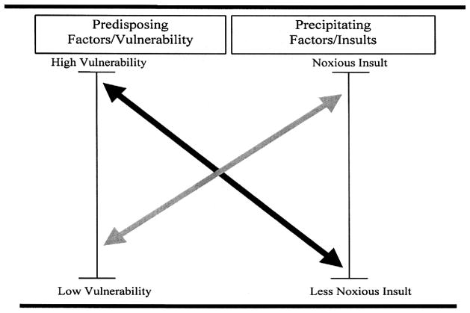
Background
Delirium is an acute severe neuropsychiatric condition, which occurs secondary to a physiological disturbance.
Lancet. 2014;383(9920):911-922
http://gemresearchuk.com
@gemresearchuk
Notes:
Delirium is related to heightened systemic inflammation leading to a central response
Increased likelihood if weaker blood brain barrier (i.e. frailty, dementia) or massive systemic inflammatory burden (i.e. sick patient)

Slide 4
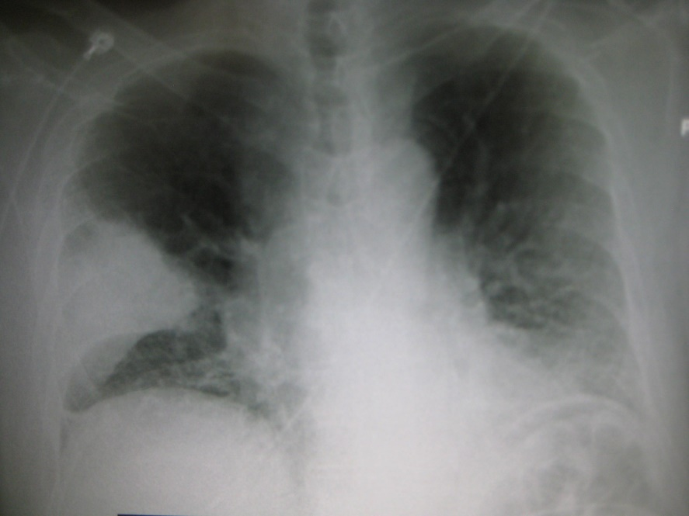
Background – outcomes
Martha vs Mary
(Mean follow-up 22.7 months)
HR 1.98 risk of death
OR 2.41 risk of institutionalisation
OR 12.52 risk of dementia
Mary 86 years-old. Pneumonia
No delirium
Martha 86 years-old. Pneumonia
Has delirium
JAMA. 2010;304(4):443-51
http://gemresearchuk.com
@gemresearchuk
Notes:
Delirium duration and severity are both predictors of negative outcomes following delirium
Recognition, can help to enable targeted prevention strategies, reducing duration and severity of delirium

Slide 5
Objectives
Primary:
Determine point prevalence of delirium in UK hospitals
Secondary:
Determine patient and hospital factors associated with screening, recognition, and prevalence of delirium
Assess impact of delirium upon 30 day outcomes in UK population
Use results to guide quality improvement and target interventions
http://gemresearchuk.com
@gemresearchuk

Slide 6
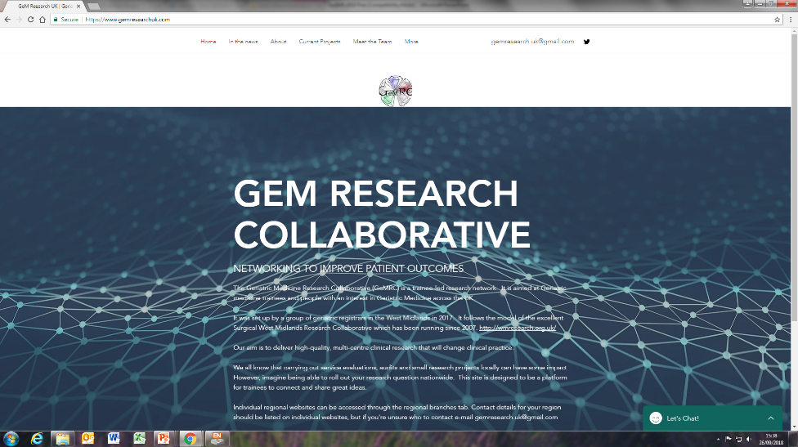
Methods
http://gemresearchuk.com
@gemresearchuk

Slide 7
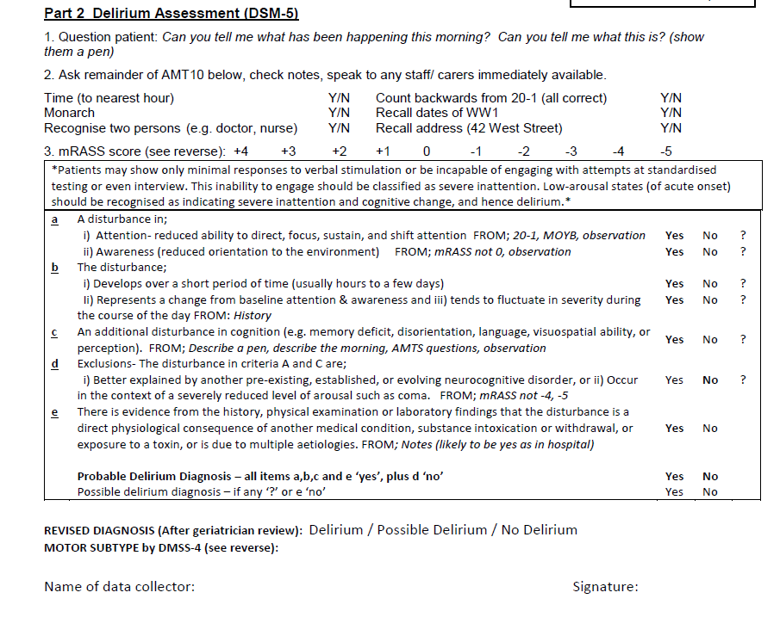
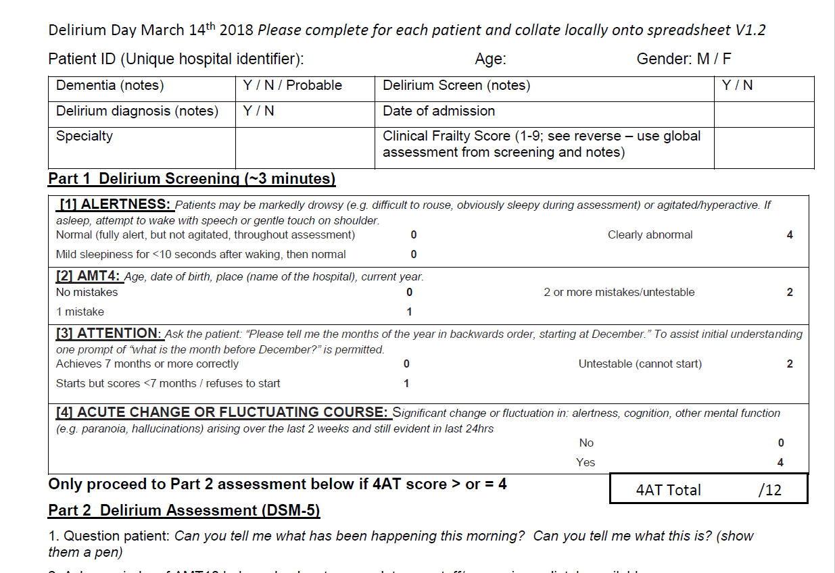
Methods
NICE Guidelines 2010
World Delirium Assessment Day – 14th March 2018
Patients aged 65 years and older
http://gemresearchuk.com
@gemresearchuk

Slide 8
Participating sites
1507 patients
45 hospitals
259 collaborators
http://gemresearchuk.com
@gemresearchuk

Slide 9
Delirium screening, prevalence, recognition
 | Screening | Prevalence |  | Recognition
Overall percentage | 27.3% | Definite delirium | 15.2% | 34.9%
 |  | Definite and possible delirium | 22.1%
 |  | 4AT positive | 24.3%
The discharge documentation was assessed for 169/229 patients with confirmed delirium.
Delirium was documented on discharge summaries in 26.6% (45/169) of these.
http://gemresearchuk.com
@gemresearchuk

Slide 10
 |  | Screening | Prevalence | Recognition
Delirium team |  | OR 2.04 (1.48-2.79); p<0.001 | OR 1.16 (0.76-1.76); p=0.488 | OR 0.39 (0.16-0.98); p=0.045
Delirium guidelines |  | OR 0.70 (0.48-1.02); p=0.064 | OR 0.91 (0.56-1.50); p=0.719 | OR 1.34 (0.41-4.34); 0.625
Delirium leaflet |  | OR 0.78 (0.60-1.01); p=0.063 | OR 0.91 (0.66-1.27); p=0.594 | OR 1.13 (0.54-2.35); p=0.097
Clerking tool |  | OR 1.14 (0.81-1.60); p=0.449 | OR 0.77 (0.52-1.16); p=0.219 | OR 2.21 (0.87-5.66); p=0.118
Geriatric medicine service in admissions unit |  | OR 0.86 (0.66-1.12); p=0.276 | OR 0.92 (0.66-1.28); p=0.623 | OR 1.62 (0.78-3.36); p=0.198
Age |  | OR 1.04 (1.02-1.06); p<0.001 | OR 1.04 (1.02-1.06); p<0.001 | OR 1.02 (0.97-1.07); p=0.427
Gender |  | OR 1.16 (0.90-1.49); p=0.261 | OR 1.06 (0.77-1.46); p=0.720 | OR 0.97 (0.49-1.93); p=0.931
Clinical Frailty Scale | 1-3 | REF; p=0.470 | REF; p<0.001 | REF; p=0.024
 | 4-6 | OR 1.15 (0.85-1.56); p=0.366 | OR 4.20 (2.38-7.38); p<0.001 | OR 0.30 (0.08-1.12); p=0.073
 | 7-9 | OR 0.96 (0.62-1.48); p=0.840 | OR 8.40 (4.46-15.83); p<0.001 | OR 0.14 (0.03-0.61); p=0.009
Dementia |  | OR 1.27 (0.91-1.78); p=0.155 | OR 1.91 (1.34-2.73); p<0.001 | OR 1.71 (0.81-3.60); p=0.161
Specialty | Acute medicine | REF; p=0.032 | REF; p=0.110 | REF; p=0.009
 | Geriatrics | OR 1.11 (0.79-1.55); p=0.545 | OR 0.91 (0.61-1.36); p=0.649 | OR 1.58 (0.72-3.47); p=0.257
 | Other medicine | OR 0.85 (0.60-1.19); p=0.331 | OR 0.59 (0.37-0.93); p=0.024 | OR 0.54 (0.18-1.60); p=0.266
 | Stroke | OR 0.72 (0.35-1.48); p=0.374 | OR 0.40 (0.11-1.33); p=0.132 | OR 3.16 (0.22-44.60); p=0.395
 | General/ other surgery | OR 0.38 (0.21-0.69); p=0.002 | OR 0.47 (0.21-1.06); p=0.070 | OR 0.04 (0.05-0.36); p=0.004
 | Orthopaedics | OR 1.04 (0.62-1.73); p=0.897 | OR 0.91 (0.47-1.77); p=0.788
http://gemresearchuk.com
@gemresearchuk

Slide 11
 |  | Screening | Prevalence | Recognition
Delirium team |  | OR 2.04 (1.48-2.79); p<0.001 | OR 1.16 (0.76-1.76); p=0.488 | OR 0.39 (0.16-0.98); p=0.045
Delirium guidelines |  | OR 0.70 (0.48-1.02); p=0.064 | OR 0.91 (0.56-1.50); p=0.719 | OR 1.34 (0.41-4.34); 0.625
Delirium leaflet |  | OR 0.78 (0.60-1.01); p=0.063 | OR 0.91 (0.66-1.27); p=0.594 | OR 1.13 (0.54-2.35); p=0.097
Clerking tool |  | OR 1.14 (0.81-1.60); p=0.449 | OR 0.77 (0.52-1.16); p=0.219 | OR 2.21 (0.87-5.66); p=0.118
Geriatric medicine service in admissions unit |  | OR 0.86 (0.66-1.12); p=0.276 | OR 0.92 (0.66-1.28); p=0.623 | OR 1.62 (0.78-3.36); p=0.198
Age |  | OR 1.04 (1.02-1.06); p<0.001 | OR 1.04 (1.02-1.06); p<0.001 | OR 1.02 (0.97-1.07); p=0.427
Gender |  | OR 1.16 (0.90-1.49); p=0.261 | OR 1.06 (0.77-1.46); p=0.720 | OR 0.97 (0.49-1.93); p=0.931
Clinical Frailty Scale | 1-3 | REF; p=0.470 | REF; p<0.001 | REF; p=0.024
 | 4-6 | OR 1.15 (0.85-1.56); p=0.366 | OR 4.20 (2.38-7.38); p<0.001 | OR 0.30 (0.08-1.12); p=0.073
 | 7-9 | OR 0.96 (0.62-1.48); p=0.840 | OR 8.40 (4.46-15.83); p<0.001 | OR 0.14 (0.03-0.61); p=0.009
Dementia |  | OR 1.27 (0.91-1.78); p=0.155 | OR 1.91 (1.34-2.73); p<0.001 | OR 1.71 (0.81-3.60); p=0.161
Specialty | Acute medicine | REF; p=0.032 | REF; p=0.110 | REF; p=0.009
 | Geriatrics | OR 1.11 (0.79-1.55); p=0.545 | OR 0.91 (0.61-1.36); p=0.649 | OR 1.58 (0.72-3.47); p=0.257
 | Other medicine | OR 0.85 (0.60-1.19); p=0.331 | OR 0.59 (0.37-0.93); p=0.024 | OR 0.54 (0.18-1.60); p=0.266
 | Stroke | OR 0.72 (0.35-1.48); p=0.374 | OR 0.40 (0.11-1.33); p=0.132 | OR 3.16 (0.22-44.60); p=0.395
 | General/ other surgery | OR 0.38 (0.21-0.69); p=0.002 | OR 0.47 (0.21-1.06); p=0.070 | OR 0.04 (0.05-0.36); p=0.004
 | Orthopaedics | OR 1.04 (0.62-1.73); p=0.897 | OR 0.91 (0.47-1.77); p=0.788
http://gemresearchuk.com
@gemresearchuk

Slide 12
 |  | Screening | Prevalence | Recognition
Delirium team |  | OR 2.04 (1.48-2.79); p<0.001 | OR 1.16 (0.76-1.76); p=0.488 | OR 0.39 (0.16-0.98); p=0.045
Delirium guidelines |  | OR 0.70 (0.48-1.02); p=0.064 | OR 0.91 (0.56-1.50); p=0.719 | OR 1.34 (0.41-4.34); 0.625
Delirium leaflet |  | OR 0.78 (0.60-1.01); p=0.063 | OR 0.91 (0.66-1.27); p=0.594 | OR 1.13 (0.54-2.35); p=0.097
Clerking tool |  | OR 1.14 (0.81-1.60); p=0.449 | OR 0.77 (0.52-1.16); p=0.219 | OR 2.21 (0.87-5.66); p=0.118
Geriatric medicine service in admissions unit |  | OR 0.86 (0.66-1.12); p=0.276 | OR 0.92 (0.66-1.28); p=0.623 | OR 1.62 (0.78-3.36); p=0.198
Age |  | OR 1.04 (1.02-1.06); p<0.001 | OR 1.04 (1.02-1.06); p<0.001 | OR 1.02 (0.97-1.07); p=0.427
Gender |  | OR 1.16 (0.90-1.49); p=0.261 | OR 1.06 (0.77-1.46); p=0.720 | OR 0.97 (0.49-1.93); p=0.931
Clinical Frailty Scale | 1-3 | REF; p=0.470 | REF; p<0.001 | REF; p=0.024
 | 4-6 | OR 1.15 (0.85-1.56); p=0.366 | OR 4.20 (2.38-7.38); p<0.001 | OR 0.30 (0.08-1.12); p=0.073
 | 7-9 | OR 0.96 (0.62-1.48); p=0.840 | OR 8.40 (4.46-15.83); p<0.001 | OR 0.14 (0.03-0.61); p=0.009
Dementia |  | OR 1.27 (0.91-1.78); p=0.155 | OR 1.91 (1.34-2.73); p<0.001 | OR 1.71 (0.81-3.60); p=0.161
Specialty | Acute medicine | REF; p=0.032 | REF; p=0.110 | REF; p=0.009
 | Geriatrics | OR 1.11 (0.79-1.55); p=0.545 | OR 0.91 (0.61-1.36); p=0.649 | OR 1.58 (0.72-3.47); p=0.257
 | Other medicine | OR 0.85 (0.60-1.19); p=0.331 | OR 0.59 (0.37-0.93); p=0.024 | OR 0.54 (0.18-1.60); p=0.266
 | Stroke | OR 0.72 (0.35-1.48); p=0.374 | OR 0.40 (0.11-1.33); p=0.132 | OR 3.16 (0.22-44.60); p=0.395
 | General/ other surgery | OR 0.38 (0.21-0.69); p=0.002 | OR 0.47 (0.21-1.06); p=0.070 | OR 0.04 (0.05-0.36); p=0.004
 | Orthopaedics | OR 1.04 (0.62-1.73); p=0.897 | OR 0.91 (0.47-1.77); p=0.788
http://gemresearchuk.com
@gemresearchuk
Notes:
Mention that screening associated with recognition OR 4.91, CI 2.48-9.72; p<0.001

Slide 13
Effect of delirium on outcomes
30 day mortality (adjusted multivariable)
OR 2.31 (1.37-3.89); p=0.002
LoS to 30 days
Median 10 days (IQR 5-18) with delirium vs. 7 (IQR 3-13) days without (p<0.001)
Bootstrapped mean (adjusted multivariable) +.3.17 days (CI 1.46-4.77), p=0.001
http://gemresearchuk.com
@gemresearchuk

Slide 14
Discussion
Delirium is common in older hospital patients
Delirium more common in frail patients but also under-recognised in frail patients
Argument to target interventions to improve screening and recognition in frail patients
Delirium more common in patients with dementia
http://gemresearchuk.com
@gemresearchuk
Notes:
No direct effect of delirium teams on recognition but may be related to powering as small numbers!
Reasonable to assume from above if delirium teams improve screening, this might improve recognition

Slide 15
Discussion
Delirium teams can improve screening but not recognition
However, screening overall improves recognition
(OR 5.35, CI 2.66-10.80; p<0.001)
Specialty does not affect delirium prevalence
Reduced odds of screening in general/other surgery
Reduced odds of recognition in general/other/orthopaedic surgery
http://gemresearchuk.com
@gemresearchuk

Slide 16
Discussion
Increased mortality, increased LoS
Did not assess institutionalisation
Unable to assess impact of recognition
http://gemresearchuk.com
@gemresearchuk
Notes:
Small numbers recognised

Slide 17
Future plans …
Round 2: Retrospective delirium ascertainment – to assess effect of recognition on outcomes
“Crowdsourcing” quality improvement
Sharing guidelines, educational tools
Round 3: Re-audit on World Delirium Assessment Day 2019
http://gemresearchuk.com
@gemresearchuk

Slide 18
Summary
Delirium is common in all specialties
Delirium is associated with increased frailty, but frailty is associated with under-recognition of delirium
Delirium is associated with increased mortality and LoS
Plenty of opportunity to get involved in our next rounds!
http://gemresearchuk.com
@gemresearchuk

Slide 19
Email gemresearchuk@gmail.com to get involved in the next two rounds!
http://gemresearchuk.com
@gemresearchuk

