Slide 1
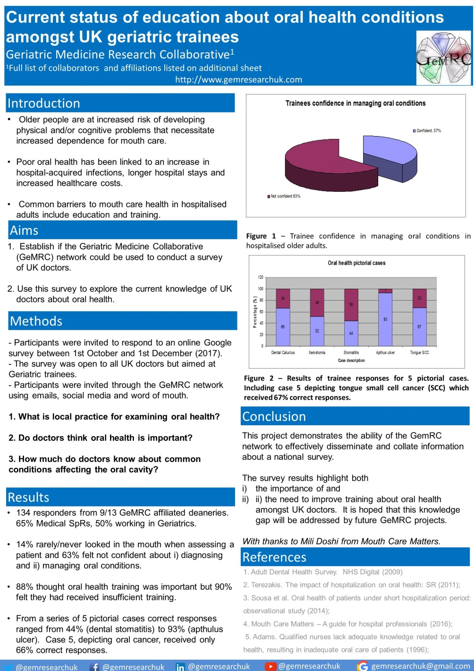
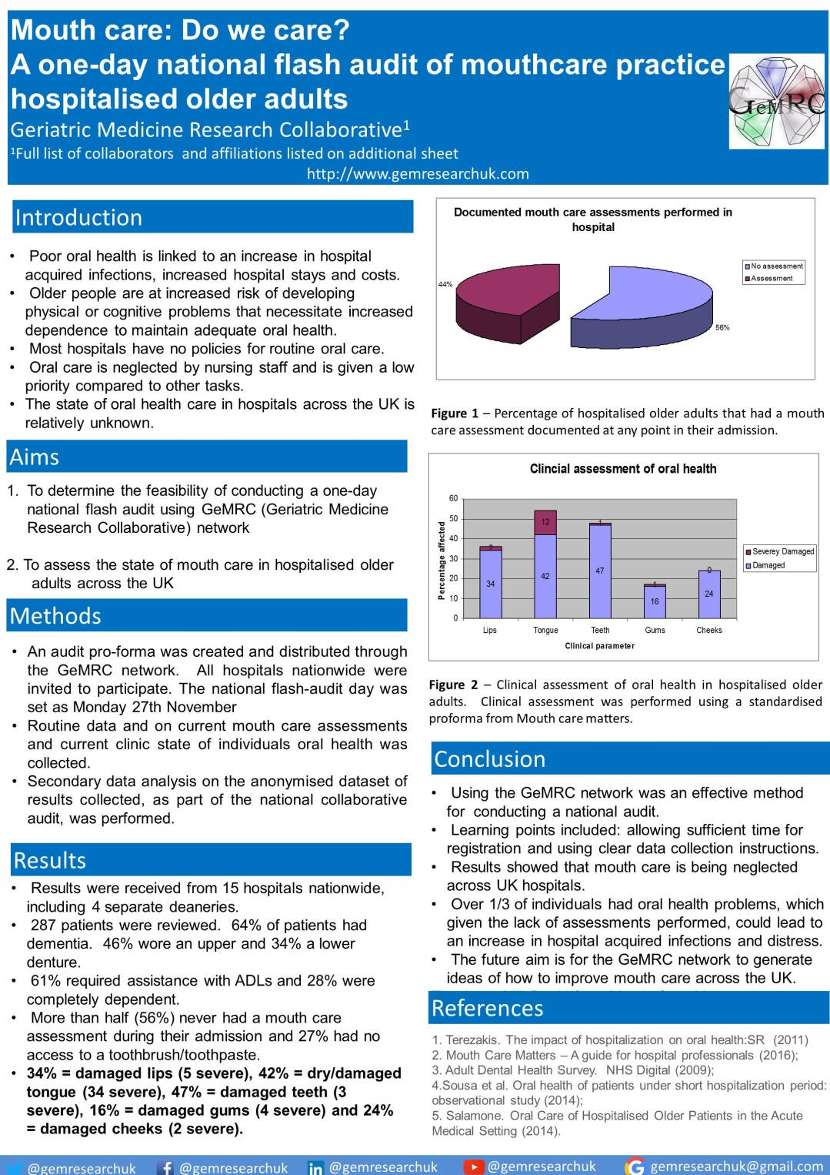
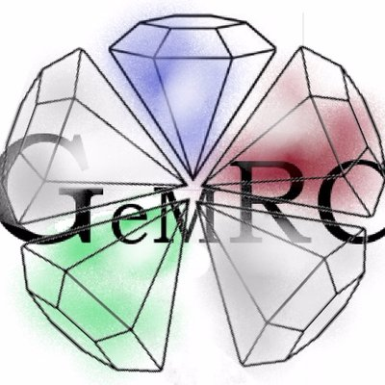
Innovations in geriatric medicine: Social media and the UKs first trainee-led research collaborative
Geriatric Medicine Research Collaborative¹
¹Full list of collaborators and affiliations listed on additional sheet
Introduction
Chief Investigators
(Trial Steering Committee)
Regional representatives
Regional representatives
Regional representatives
Local leads
Local leads
Local leads
Local leads
Local leads
Local leads
Data collectors
Data collectors
Data collectors
Data collectors
Data collectors
Data collectors
Social media and online networking provides an innovative approach to development and promotion of a research collaborative. Using this model we set up the UKs first trainee-led Geriatric Medicine Research Collaborative (GeMRC) to improve trainees experience in research and patient care.
Aim
To set up the first UK trainee-led geriatric medicine research collaborative
Objectives
To enable conduct of audit and research projects with early and direct impact on patient care.
To enable geriatric trainees to develop their competencies in research, audit, and quality improvement
Figure 2 – Organisation of our collaborative
For most projects, there will be a central organising committee who is responsible for liaising with regional representatives, who in turn liaise with local representatives
Methods
Results
Using social media and a trainee-led “grass-roots” approach, GeMRC now has representatives from 14 of the 15 regions in the United Kingdom. We created national and regional websites to disseminate project information, and utilised a combination of e-mail communication, social networking, word-of-mouth, and dissemination through the British Geriatrics Society. Project ideas were generated by trainees at regular meetings and communicated to regional representatives.
We have successfully completed three national audit projects, and are refining the protocols for two Randomised Controlled Trials (RCTs). We have now successfully published one journal article, seven conference abstracts, and have further articles under consideration. Initial results of our “Delirium Day” audit are being presented orally at the EuGMS.
Website
Social media
Emails, WhatsApp, Virtual meetings
Word of mouth
Regional and national meetings
National
Regional
“Involve”
Twitter
Facebook
LinkedIn
YouTube
Gmail
Via regional leads
Trainee bulletin
Updates to trainees and trainers
Discussion at Specialty Advisory Committee meetings
Other specialties
Results
Conclusion
The Geriatric Medicine Research Collaborative (GeMRC) offers an innovative approach to research. It facilitates the opportunity for trainees with limited research experience to participate in research that has early impact upon patient care. The use of social media and online networking allows rapid dissemination of project ideas which facilitates collection of much larger datasets and enhances the scientific validity of project outcomes. We welcome collaboration with European sites in the future.
Figure 1 – Our process of dissemination of our collaborative
Creating a recognisable online brand helped to facilitate national engagement of our collaborative with trainees across each training region, as well as all necessary stakeholders (i.e. consultants, hospital managers)
Geriatric Medicine Research Collaborative
http://gemresearchuk.com
@gemresearchuk
@gemresearchuk
@gemresearchuk
gemresearchuk@gmail.com
@gemresearchuk

