Slide 1
The Geriatric Medicine Research Collaborative (GeMRC): inception and dissemination of a new national trainee-led research collaborative
Dr Carly Welch MBChB MRCP(UK) MAcadMEd
ACF ST5 Geriatric Medicine
Dr Lauren McCluskey BSc MBChB MRCP(UK)
ACF ST5 Geriatric Medicine
On behalf of GeM Research UK
http://gemresearchuk.wixsite.com/national
@gemresearchuk

Slide 2
Take home points
Future projects
Purpose of the collaborative
How to get involved
Progress to date
http://gemresearchuk.wixsite.com/national
@gemresearchuk
Notes:
Lauren

Slide 3
Background
Research collaboratives exist for many other specialties
Most notable – general surgery
Initially “West Midlands Research Collaborative”, developed links to form “National Surgical Research Collaborative” and now “GlobalSurg”
Increased trainee participation in research
PubMed citable publications for all collaborators
RCTs performed with small(ish) budgets by early career researchers – early impact on patient care
http://gemresearchuk.wixsite.com/national
@gemresearchuk
Notes:
Lauren

Slide 4
Purpose and premise
Move from the traditional view of research
Opportunities for more trainees to get involved in research
Facilitate trainees to gain competencies in audit, research, and QIP
Conduct research with early impact on patient care
Flexible approach
All collaborators acknowledged in presentations and publications
Modelled on surgical collaborative (WMRC)
http://gemresearchuk.wixsite.com/national
@gemresearchuk
Notes:
Lauren

Slide 5
First Meeting 28th September 2017
Website
Pizza
Beer
http://gemresearchuk.wixsite.com/national
@gemresearchuk
Notes:
Carly

Slide 6
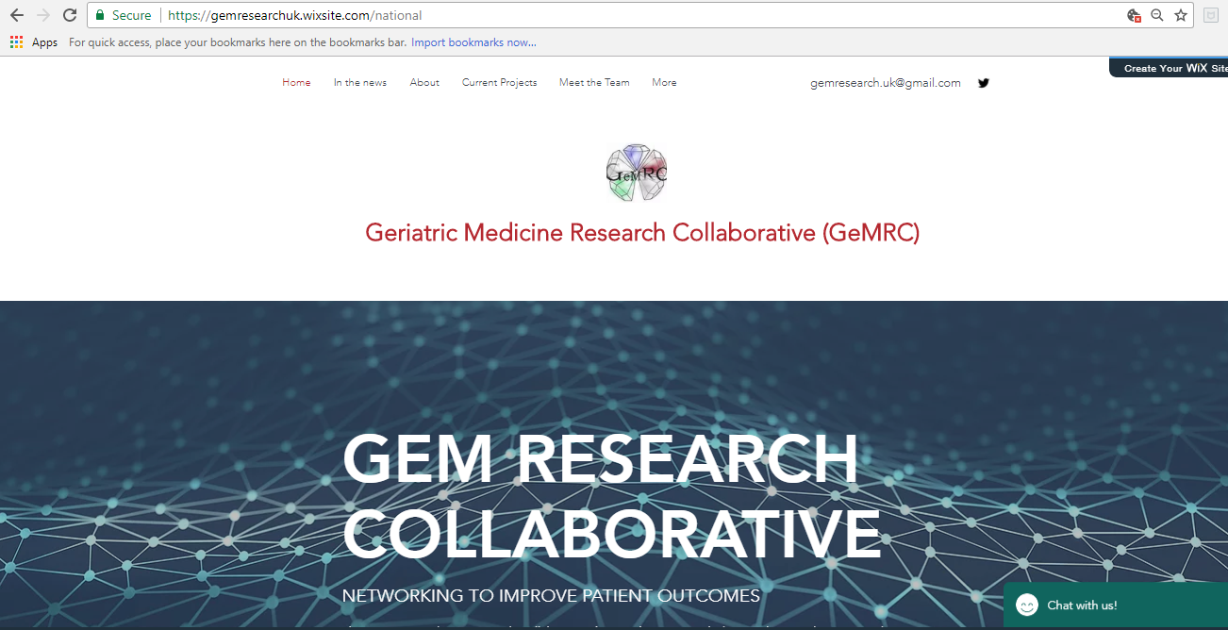
Dissemination of our collaborative
Website
Social media
Emails
Word of mouth
Regional meetings
National
Regional
“Involve”
Twitter
Facebook
LinkedIn
YouTube
gemresearchuk@gmail.com
Via regional representatives
Trainee bulletin
Updates to trainees and trainers
…And now national!
Discussion at SAC
Other specialties
WhatsApp
Virtual meetings
http://gemresearchuk.wixsite.com/national
@gemresearchuk
Notes:
Carly

Slide 7
Design
Chief Investigators
(Trial Steering Committee)
Regional representatives
Regional representatives
Regional representatives
Local representatives
Local representatives
Local representatives
Local representatives
Local representatives
Local representatives
Data collectors
Data collectors
Data collectors
Data collectors
Data collectors
Data collectors
http://gemresearchuk.wixsite.com/national
@gemresearchuk
Notes:
Carly

Slide 8
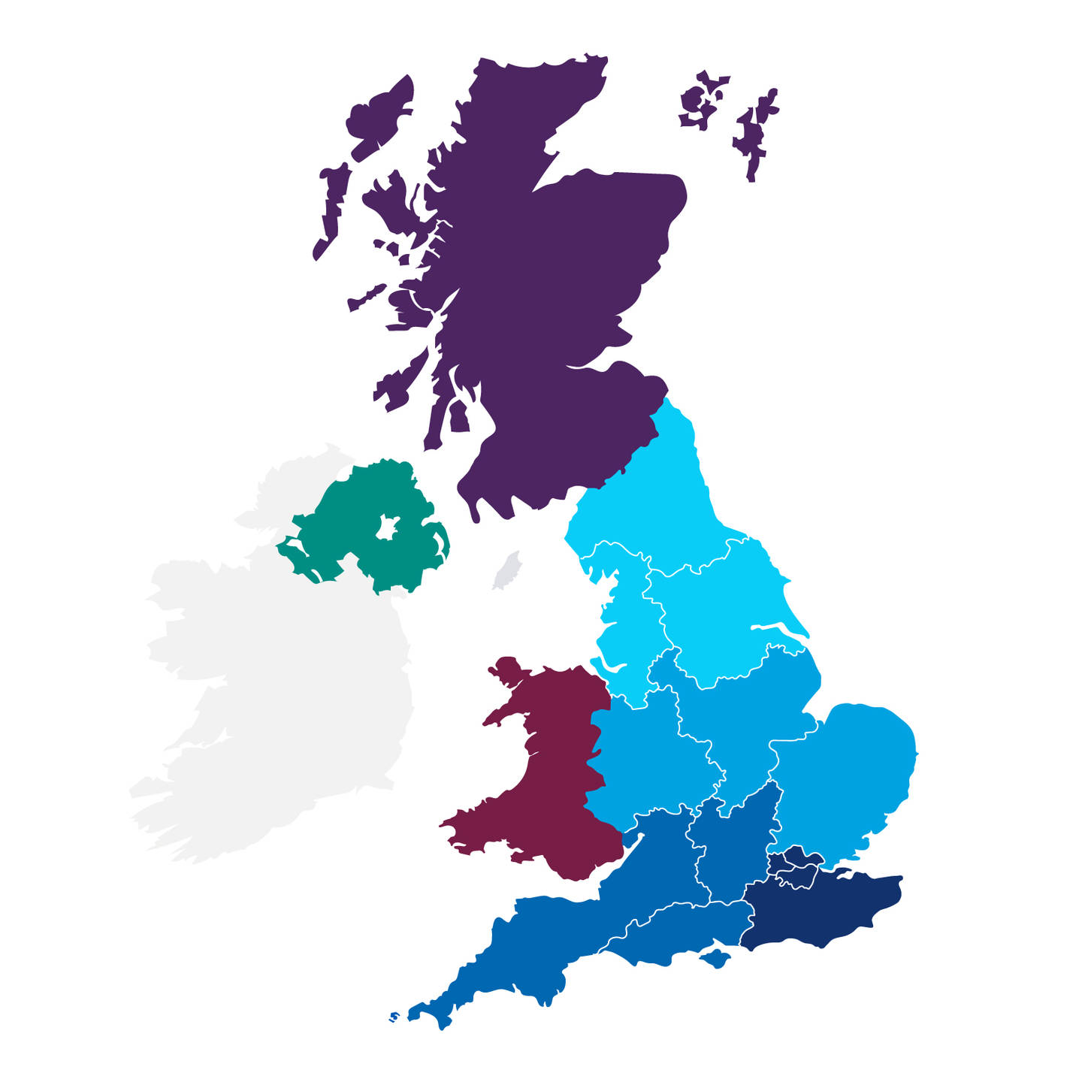
Regions involved
MIA:
Scotland
Oxford
Northern Ireland
Northern (North East)
Yorkshire
North West
East Midlands
Wales (WeGeN)
East of England
West Midlands
Severn
London
(currently all)
Peninsula
Kent, Surrey, and Sussex
Wessex
http://gemresearchuk.wixsite.com/national
@gemresearchuk
Notes:
Carly

Slide 9
Being part of GeMRC
http://gemresearchuk.wixsite.com/national
@gemresearchuk
Notes:
Regional reps giving their opinion on GeM

Slide 10
Progress to date
One paper submitted to Journal of Medical Internet Research: Research Protocols - authorship will include all regional leads and start up committee
Awarded £1000 WMBGS Start-Up Grant - for internet upgrade, teleconferencing, PPI
Three national audits and one national survey completed
Four abstracts submitted and accepted to Spring National BGS meeting
- platform presentation, three posters; all involved included as authors!
http://gemresearchuk.wixsite.com/national
@gemresearchuk
Notes:
Lauren

Slide 11
Completed and ongoing projects
Perioperative management of anaemia in patients with fractured necks of femurs*
Data from 309 patients from six hospitals
Service evaluation of mouth care assessment in UK hospitals*
Data from 287 patients from 15 hospitals
Evaluation of knowledge of mouth care assessment amongst UK medical doctors*
134 responses from nine different regions
Evaluation of assessment and recognition of delirium in UK hospitals
Collection of follow-up data ongoing prior to analysis
67 hospitals registered to participate
FErric carboxymaltose prevents blood proDuct usage following Operative management of neck of Femur Fractures (FEND-OFF)
Funding application being refined for NIHR RfPB – extended feasibility trial
*Posters on display here!
http://gemresearchuk.wixsite.com/national
@gemresearchuk
Notes:
Lauren

Slide 12
How to get involved
Log on (chat online), Tweet us, email us, talk to us!
Contact your regional rep about ongoing projects
Volunteer as a local rep if your hospital doesn’t have one (or regional if you are from Scotland or Oxford!)
Suggest any project ideas
Help us spread our collaborative!
http://gemresearchuk.wixsite.com/national
@gemresearchuk
Notes:
Carly

Slide 13
Suggestions for future projects
Go to www.slido.com
Type in code: Z520
Select all the projects you would be interested in taking part in (can select multiple!)
http://gemresearchuk.wixsite.com/national
@gemresearchuk
Notes:
Carly

